Slide 1

Welcome

Slide 2

Notes:
2

Slide 3
Rules
Notes:
Set your rules for your class and don’t follow them from the first time

Slide 4
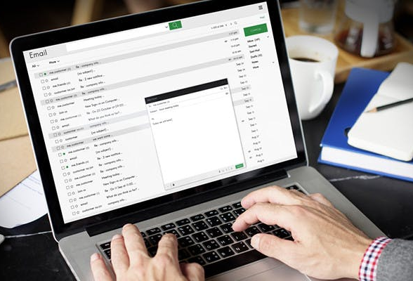
Email and business writing

Slide 5

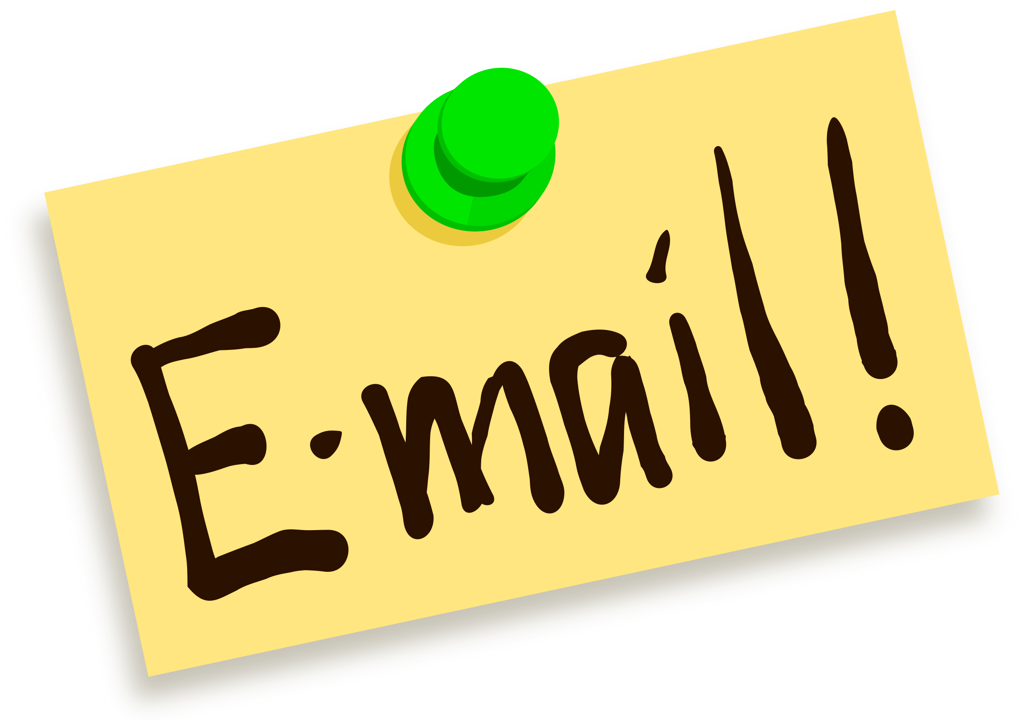
Agenda:
GTKY
Introduce yourself by email.
Request information by email.
Reply by email to a previous communication
Choose the appropriate email closing.
Set the right tone in emails.
Communicating using instant messaging.
Recapping

Slide 6
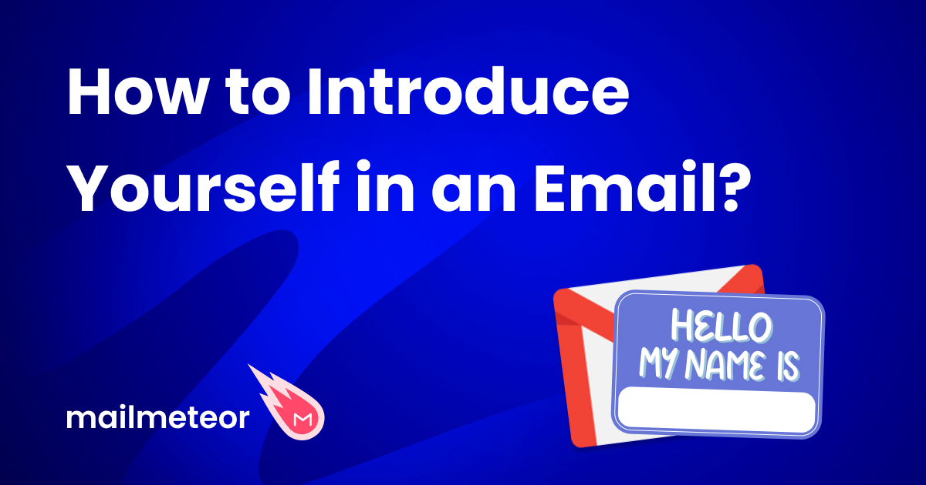

Slide 7

Discuss with your classmates:
Why is it good to make people like you when you talk at work?
Why are first emails important for finding jobs or meeting new people?
How do you tell someone who you are in an email?
What should you write in your first email to someone?
How short or long should your first email be?
Can you ask someone to do something in your first email?
What do you do after you send your first email to someone?

Slide 8
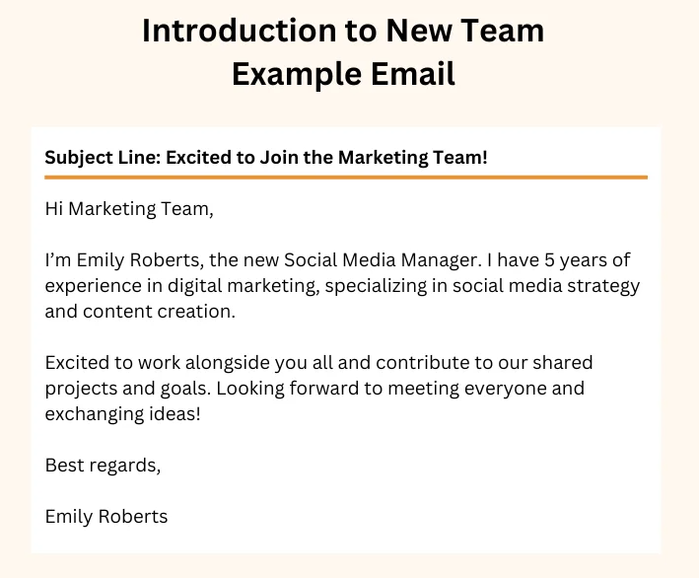
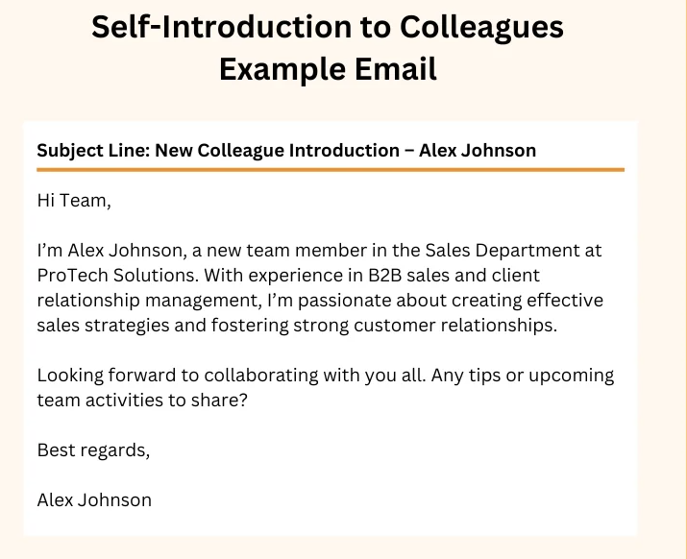
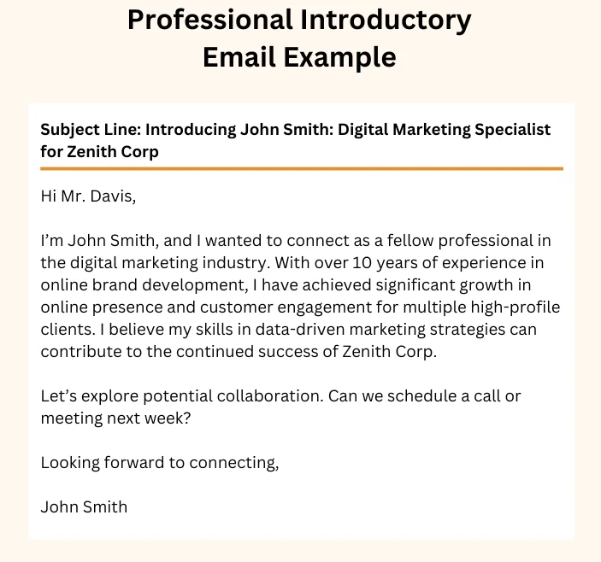
"In small groups, look at the examples and find the good parts in each introduction."
Example 1
Example 2
Example 3
Notes:
8

Slide 9
What important parts should be in the email you send?
Subject line
Greeting
Introduction
(name, position, purpose of email)
Brief background or relevant experience
Closing statement
Signature

Slide 10
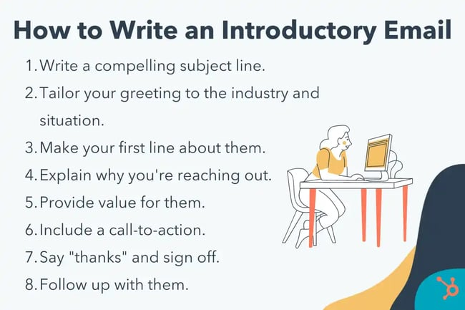

Slide 11
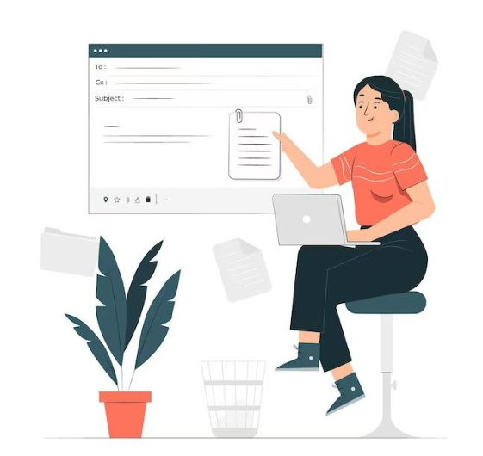
how to write a successful introduction email?!

Slide 12
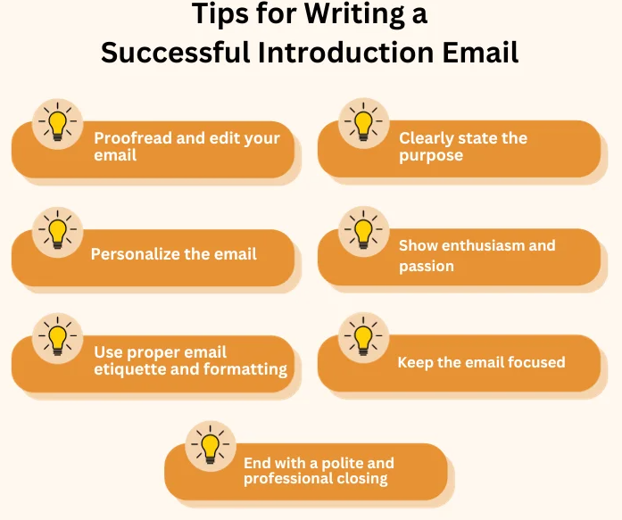

Slide 13
tips on how to write introduction E-mails
Check your email for mistakes and make it sound nice.
Use the person's name and say why you want to talk to them.
Write your email politely and make it easy to read.
Say why you're writing and how you can help.
Show that you're excited to talk.
Keep it short and don't add extra stuff. End your email politely and maybe ask them to do something next."

Slide 14
Complete the missing phrases
Subject: Introduction and [Position/Reason for Contact]
Dear [Recipient's Name],
I hope this email finds you well. My name is [Your Name], and I am reaching out to [reason for contact]. I recently came across [mention how you found out about the recipient or their organization] and was impressed by [mention something specific about the recipient or their work].
A little bit about myself: I have [mention relevant experience or background]. I am particularly passionate about [mention your interests or areas of expertise related to the reason for contact]. I believe that my skills in [mention relevant skills] could be of value to your team or project.
I am eager to learn more about [mention what you want to learn or discuss further]. Would it be possible to schedule a [meeting/call] at your convenience? I am available [mention your availability].
Thank you for considering my request. I look forward to the opportunity to [mention your goals or expectations].
Best regards,
[Your Name]
[Your Contact Information]
Notes:
14

Slide 15
How to introduce yourself in an email.
Step one
Understand who you're writing to and why.
Step two
Use the right tone, like being friendly or respectful.
Step three
Keep it short and interesting.
Step four
Make it about them, like saying why you want to connect.
Step five
Make sure your email looks nice and polite.

Slide 16

Write your own introductory emails using the knowledge and skills you’ve gained from the lesson. Remember to refer to the email writing guidelines and sample introductions as needed.

Slide 17

How to write an effective requesting more information

Slide 18
Discuss with your classmates:
What's the main thing to think about before writing to ask for information?
Do I need to email them?
Who can help me?
Notes:
18

Slide 19
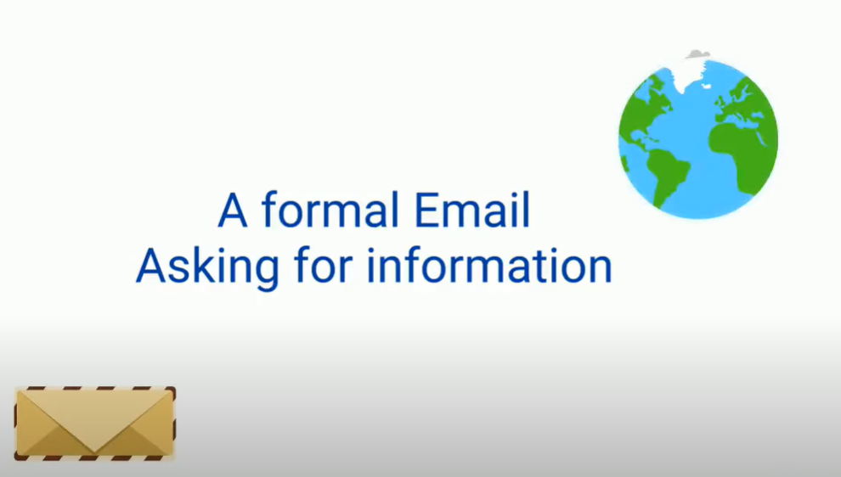
https://www.youtube.com/watch?v=7LYhNAqTehU
Talk about the main points and give a summary.
What parts should be in an email asking for information?

Slide 20
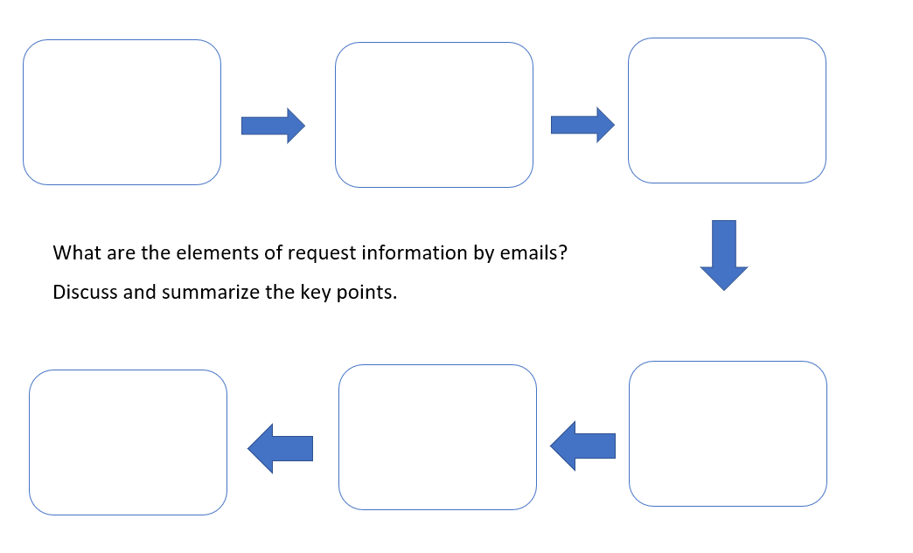
Notes:
20

Slide 21
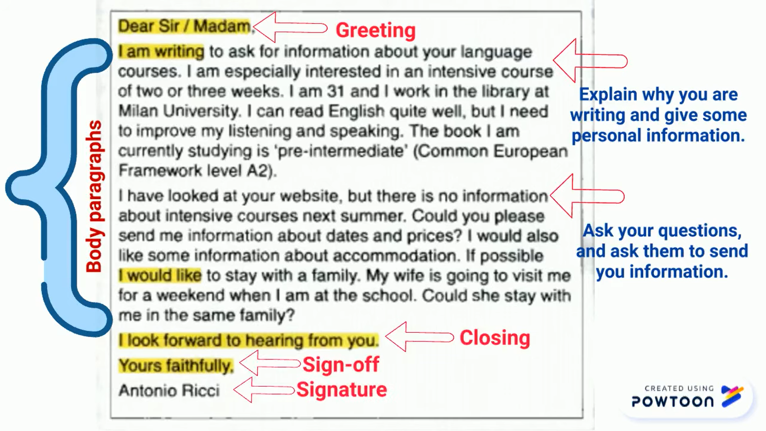
Notes:
21

Slide 22
In pairs,
Write a draft of an email requesting the necessary information, following the email writing guidelines.
Notes:
22

Slide 23
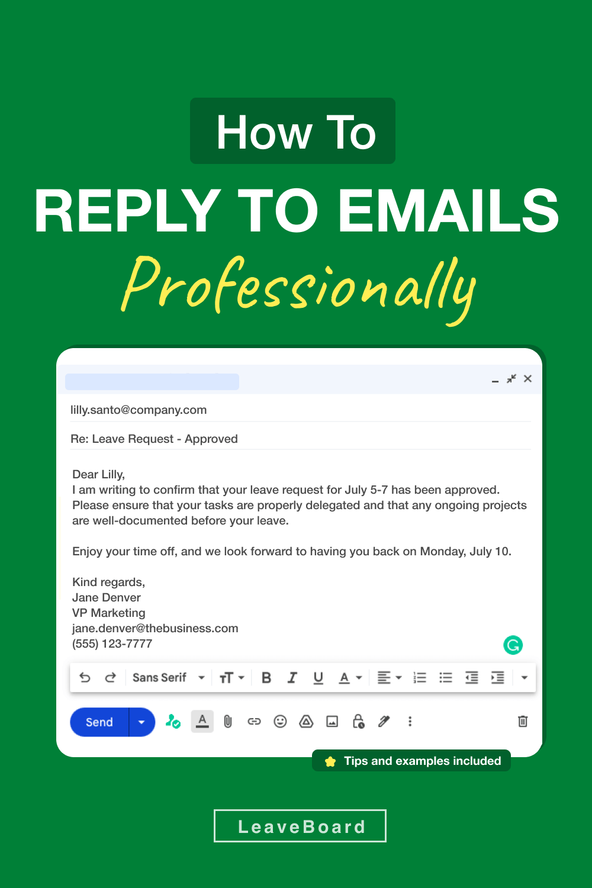
Discuss the two questions with your classmates:
What is a response email?
How to respond to an email professionally?

Slide 24
6 Steps to Writing a Professional Email Response
1. Please read the message
2. Find clues
3. It’s worth it
4. Your response should be written
5. Invite a reply
6. Get feedback

Slide 25
6 Steps to Writing a Professional Email Response
1. Please read the message
2. Find clues
3. It’s worth it
This means to carefully read the email you received before replying. It's important to understand what the sender is asking or saying.
Look for important information or hints in the email that can help you understand what the sender wants or needs. Clues can be keywords, questions, or requests.
This means that taking the time to understand and respond to the email is important. It's worth the effort to provide a helpful and polite response.
4. Your response should be written
5. Invite a reply
6. Get feedback
You need to reply to the email with a written message. This can be done by typing a response in the email or using an email writing tool.
You can do this by ending your email with a friendly phrase like "Feel free to ask if you have any more questions."
After sending your email, it's good to ask someone else to read it and give you feedback. This can help you improve your email writing skills for next time.
Notes:
1. **Please read the message**: This means to carefully read the email you received before replying. It's important to understand what the sender is asking or saying.
2. **Find clues**: Look for important information or hints in the email that can help you understand what the sender wants or needs. Clues can be keywords, questions, or requests.
3. **It’s worth it**: This means that taking the time to understand and respond to the email is important. It's worth the effort to provide a helpful and polite response.
4. **Your response should be written**: You need to reply to the email with a written message. This can be done by typing a response in the email or using an email writing tool.
5. **Invite a reply**: Encourage the sender to respond back if they have any further questions or need more information. You can do this by ending your email with a friendly phrase like "Feel free to ask if you have any more questions."
6. **Get feedback**: After sending your email, it's good to ask someone else to read it and give you feedback. This can help you improve your email writing skills for next time.

Slide 26
Top 10 tips for effectively replying to an email
1. Read the whole email before you write back.
2. Make sure what you say fits with what they asked.
3. Keep it short and clear.
4. Write correctly and without mistakes.
5. Be nice and professional in how you write.
6. Reply quickly.
7. Use numbers or bullets to organize your reply.
8. Say what you want them to do next.
9. Check for mistakes in what you wrote.
10. Start with a subject and a greeting in your email.

Slide 27
Time to write, but first think about:
What is the purpose of the email reply in this scenario?
Who are the intended recipients of the email?
What information needs to be included in the reply?
What tone and level of formality are appropriate for the situation?
Now, individually write a draft an email reply to a scenario
Think of add a polite greeting
Add the content of your reply as the body of the email
End the email professionally
Notes:
27

Slide 28
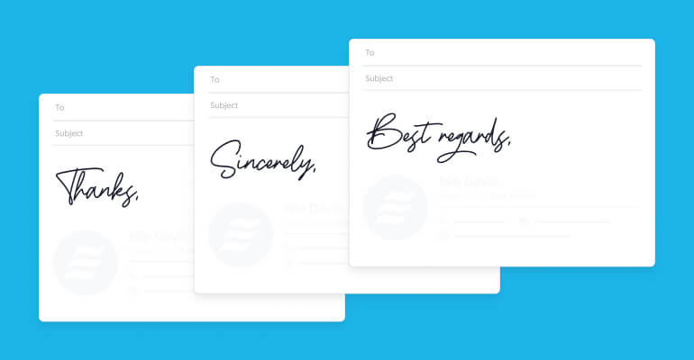
What does "Email Closing" mean?
How does Email Closing affect communication?
What are the important parts of an email ending?

Slide 29
Answer the following questions regarding the provided samples:
What is the feeling of each email, and how does the ending make that feeling stronger?
Who is each email for, and how does the ending change depending on that?
In what jobs would each ending be okay?
How do things like being polite or knowing someone well affect the ending?
How does saying goodbye help make the emails better and make friends?
Notes:
29

Slide 30
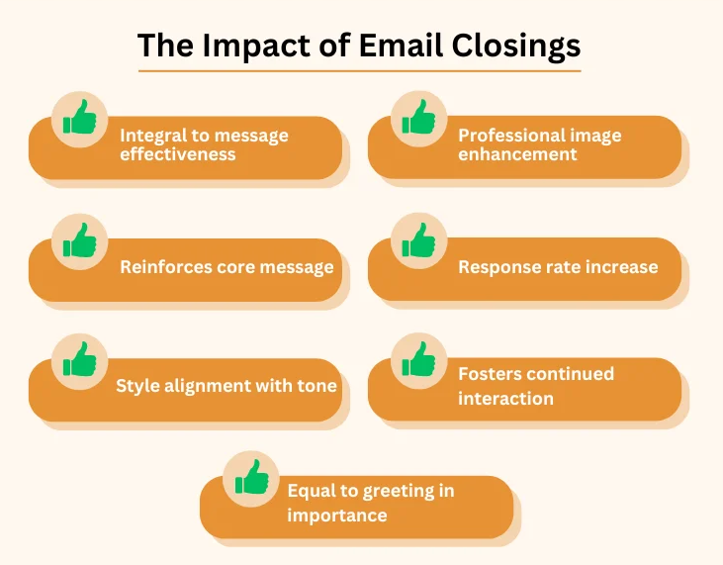

Slide 31
Email endings are important for making your message better.
They help make you look professional
Endings remind people about the main point of your message
When you use a good ending, people are more likely to answer you.
Good endings help you keep talking to people.
Endings should match how you talk in your message.
Saying goodbye in emails is as important as saying hello.

Slide 32
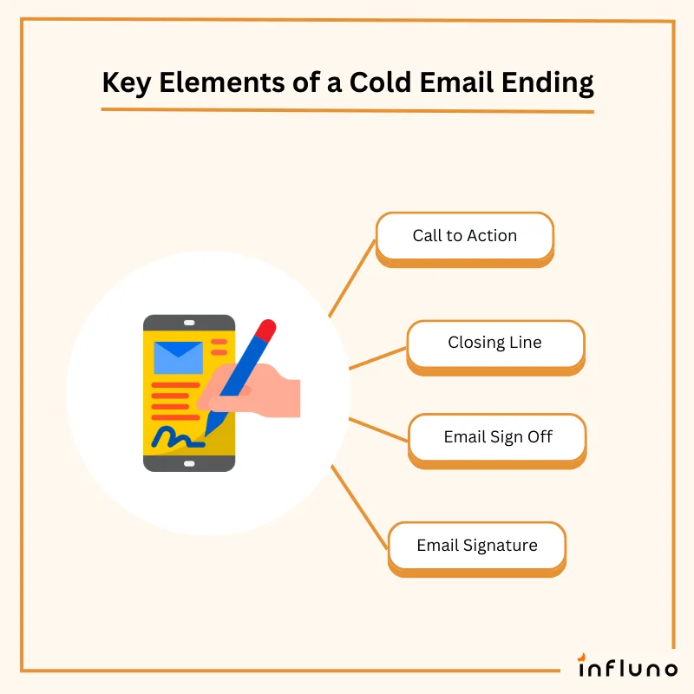
What are the important parts of saying goodbye in an email?

Slide 33
Provide an email closing for the below scenarios.
Scenario 1: Asking About Products You are a salesperson answering a customer's questions about your company's stuff. They want to know more about prices and when they can get it.
Scenario 2: Sharing Project News You're a project manager updating your team on how things are going with the project. You'll tell them about what's happened lately and what's coming up next.
Scenario 3: Fixing a Problem You work in customer service and someone complained about a problem with your company's stuff. You need to make them feel better and fix the problem.
Scenario 4: Saying Thanks After a Meetup You went to a meeting with other people in your field. Now you want to thank them for talking with you and maybe work together later.
Scenario 5: Answering a Job Application You're a boss telling someone they didn't get the job they wanted. But you want to say thanks for trying and maybe they'll get another chance later.
Scenario 6: Inviting People to a Meeting You're setting up a meeting with your coworkers to talk about the next things you're doing. You need to tell them when and where it is.
Scenario 7: Asking About Stuff You want to buy some things for a new project. You're emailing companies to ask how much they cost and when they can send them.
Scenario 8: Saying Thanks to a Worker You're a team leader telling one of your coworkers they're doing a great job. You want to say thanks for all the hard work they've done.
Notes:
33

Slide 34


